Slide 1
Meiosis
Year 11 Human Biology
ATAR
PowerPoint #17

Slide 2
SCSA Syllabus Reference
meiosis produces gametes for reproduction and involves DNA replication, chromosome pairing, and two successive nuclear divisions distributing haploid sets of chromosomes to each gamete
crossing over, non-disjunction and random assortment of chromosomes during meiosis will produce gametes with different genetic content

Slide 3
Lesson Intention
To explore the process of meiosis
To compare and contrast the process of mitosis and meiosis
To explore the process of variation in the genotypes of offspring

Slide 4
Success Criteria
explain the production of gametes
summarise the process of meiosis using a table or annotated diagram
explain the difference between the first and second meiotic divisions
compare and contrast the processes of mitosis and meiosis
explain the process of crossing over
explain the process of non-disjunction
explain the process of random (or independent) assortment

Slide 5
Vocabulary
Gamete: a sperm or egg cell
Meiosis: a type of cell division resulting in sperm or eggs; the sperm or eggs have half the chromosome number of the parent cell
Fertilisation: fusion of sperm and egg
Diploid: the number of chromosomes in a cell with both chromosomes from each homologous pair

Slide 6
Vocabulary
Haploid: the number of chromosomes in a cell with only one chromosome from each homologous pair; half the diploid number
Homologous Chromosomes: the pairs of chromosomes containing genes that control the same characteristics
Prophase I: the first phase of the first stage of meiosis, during which the chromosomes become visible, the nuclear membrane breaks down and the spindle forms

Slide 7
Vocabulary
Metaphase I: the second phase of the first stage of meiosis, during which the homologous chromosomes line up on the equator
Anaphase I: the third phase of the first stage of meiosis, during which the homologous chromosomes move to opposite ends of the cell
Telophase I: the fourth phase of the first stage of meiosis, during which the new nuclear membrane forms

Slide 8
Vocabulary
Prophase II: the first phase of the second stage of meiosis, during which the nuclear membrane disappears and the spindle forms
Metaphase II: the second phase of the second stage of meiosis, during which the chromosomes line up on the equator
Anaphase II: the third phase of the second stage of meiosis, during which the daughter chromosomes move towards opposite ends of the cell

Slide 9
Vocabulary
Telophase II: the fourth phase of the second stage of meiosis, during which the new nuclear membrane forms
Crossing over: the interchange of the parts of the chromatids of a homologous pair of chromosomes during the first stage of meiosis; it creates new combinations of alleles.
Chiasma: the point at which crossing over occurs between chromatids

Slide 10
Vocabulary
Recombination: a changing of the order of alleles along a chromosome
Non-disjunction: when one or more of the chromosome pairs fail to separate during meiosis
Trisomy: a condition in which an individual inherits an extra copy of a chromosome
Down Syndrome: a genetic disorder resulting from an extra copy of chromosome 21

Slide 11
Vocabulary
Monosomy: when an individual has only one copy of a chromosome instead of two
Partial monosomy: when a person has part of a chromosome missing
Partial trisomy: when a person has part of an extra chromosome
Independent assortment: the random combination of alleles due to allele pairs separating independently of one another

Slide 12
Producing Gametes
Gametes are produced in the reproductive organs.
Meiosis results in gametes with HALF the amount of chromosomes (23- Haploid), so when they fuse together, they will have 46 chromosomes (Diploid).
The chromosomes in diploid cells exist in pairs identical in shape and size and are called homologous chromosomes.

Slide 13
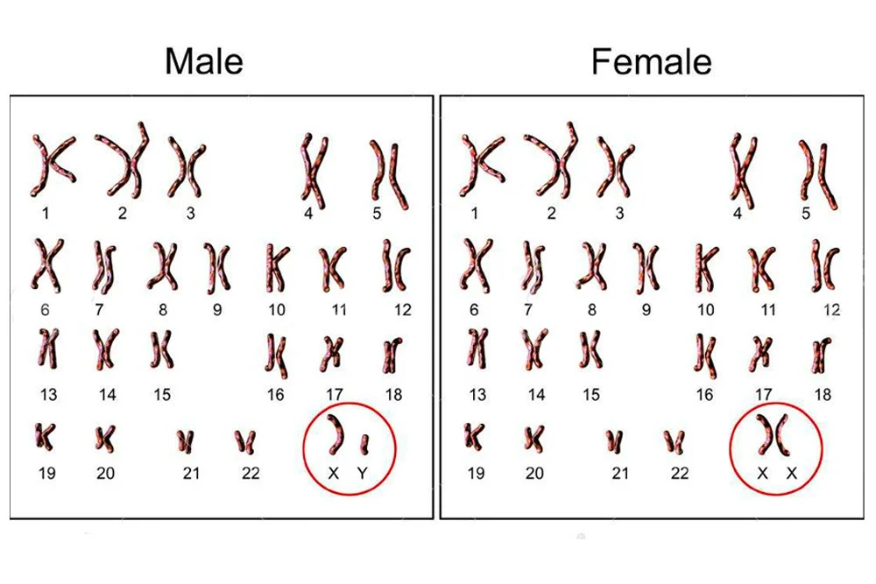

Slide 14
Diploid and Haploid
When a cell has two of each type of chromosome, it has the diploid chromosome number (2n).
In gametes, only one of each type of chromosome is present, or n, and therefore it is a haploid cell (n).

Slide 15
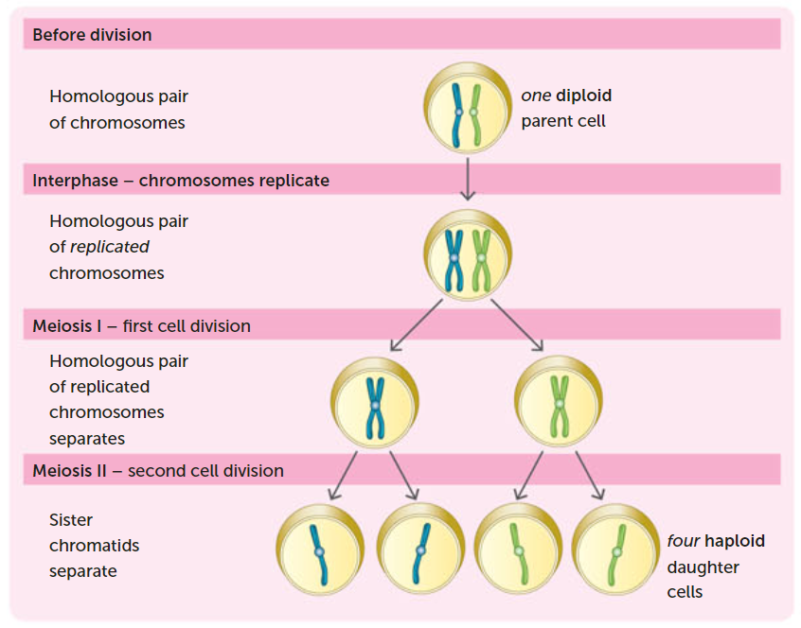

Slide 16
First Meiotic Division
The first stage of meiosis starts with the chromosomes pairing off during the prophase stage.
During Prophase I, the chromosomes become visible as long threads. They move to lie alongside each other, then shrink and thicken as the DNA becomes more tightly coiled. As each chromosome consists of 2 chromatids, each chromosome pair appears as four strands which frequently twist together.

Slide 17
First Meiotic Division
A spindle then forms, stretching between the poles of the cell. The paired chromosomes move towards the spindle fibres until at Metaphase I, they are arranged on the spindle fibre across the equator of the cell.
At Anaphase I, the pairs of homologous chromosomes move apart, with one member of each pair moving to each pole of the cell. During Telophase I, the chromosomes decondense and the nuclear membrane may reform. Cytokinesis also occurs, producing two cells.

Slide 18
Second Meiotic Division
During the second division, each daughter cell with it 23 chromosomes undergoes the same sequence of events resulting in four haploid cells being produced.
During Prophase II, a new spindle forms at each end of the original spindle and usually at right angles to the original. The chromosomes in each cell gradually move towards the equator, so that at Metaphase II, they are arranged on the new spindle.

Slide 19
Second Meiotic Division
The centromeres then divide, so that each chromatid is now a separate chromosome. These new chromosomes migrate to opposite poles of the cell (Anaphase II). Nuclear membranes begin to form and the cytoplasm starts to divide (Telophase II and Cytokinesis).
By the end of the second division, four haploid cells have been formed.

Slide 20
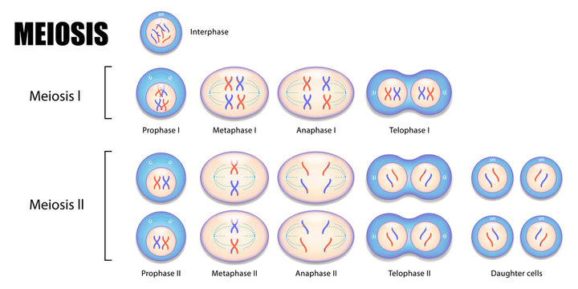

Slide 21
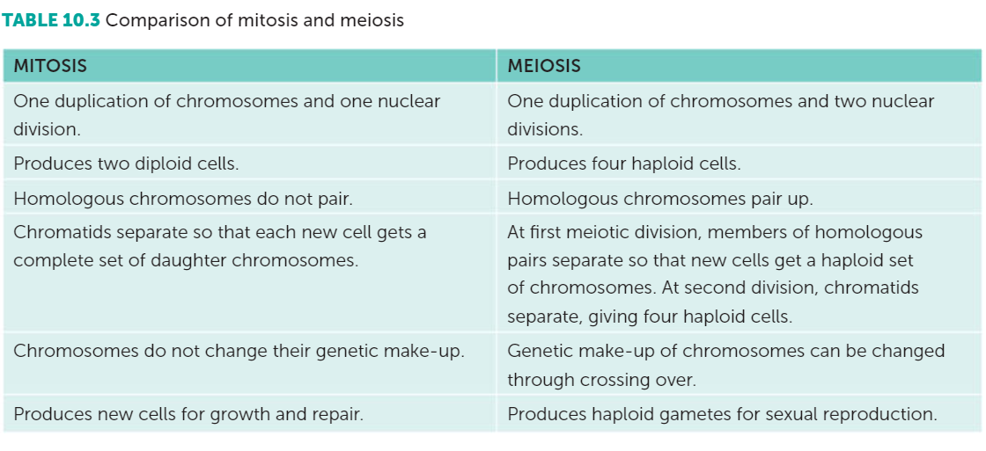
Differences between mitosis and meiosis

Slide 22
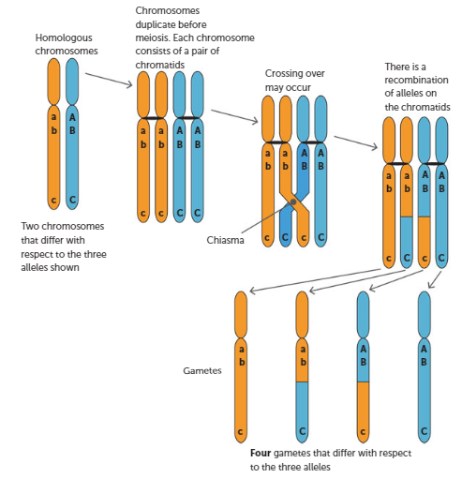
Variation in Daughter Cells
Crossing Over:
Occurs during Prophase of the first meiotic division
When the homologous chromosomes are paired, chromatids may cross, break and exchange segments (crossing over)
The point where two chromatids cross is called a chiasma.
Crossing over can result in a new combination of genes, creating variation

Slide 23
Variation in Daughter Cells
Non-disjunction
Occurs in two places (during the first or second meiotic division)
Result in one of the daughter cells receiving an extra chromosome and the other daughter cell lacking the chromosome.
This will produce unexpected characteristics in the offspring such as distinctive birth defects. Miscarriages are common.
E.g. Trisomy is when an individual inherits an extra copy of a chromosome. For people with Down Syndrome (Trisomy 21), an extra copy of chromosome 21 results in characteristic facial appearances, variable degrees of intellectual disability and physical abnormalities.

Slide 24
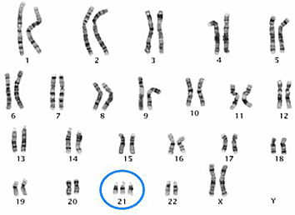
Variation in Daughter Cells
Non-disjunction (continued)
Monosomy is where an individual is missing a chromosome. It usually results in severe malformations and often miscarriage
Partial monosomy and partial trisomy can also occur.
Down Syndrome Karyotype

Slide 25
Variation in Daughter Cells
Random (or independent) assortment
During the first meiotic division, the homologous pairs of chromosomes separate. When they separate, they do so at random.
This random, independent assortment takes place for each of the 23 pairs of chromosomes, meaning any single human egg receives one of two possible chromosomes 23 times (total number of combinations is 8.4 million just for eggs)
The same random, independent assortment goes for sperm too

Slide 26
Recall Knowledge
Where does meiosis occur?
List three processes that lead to variation between daughter cells.
Explain how non-disjunction can lead to Down Syndrome

Slide 27
Apply Knowledge
The Tasmanian Devil has a diploid umber of 14. State its haploid number.
Explain why meiosis has two stages, whereas mitosis only has one.
Describe random assortment with reference to chromosomes

Slide 28
Homework
Explain how each of the following leads to variation in daughter cells:
Independent assortment
Non-disjunction
Crossing over

Slide 29
Reading
Pages 254 - 261: Cells divide for growth, repair, replacement and reproduction

